Slide 1
Early Reading and Phonics
EYFS and KS1 Parents Meeting
Friday 7th October 2022

Slide 2
An overview of this morning
To share our approaches to early reading at Widmer End.
To develop your confidence in helping your children read at home.
To give an overview of our RWI phonics scheme.
To give parents an opportunity to ask questions.

Slide 4
Reading books and records
New reading records - our expectations
EYFS - Lilac wordless books
Decodable phonics books
School books
Library books

Slide 5
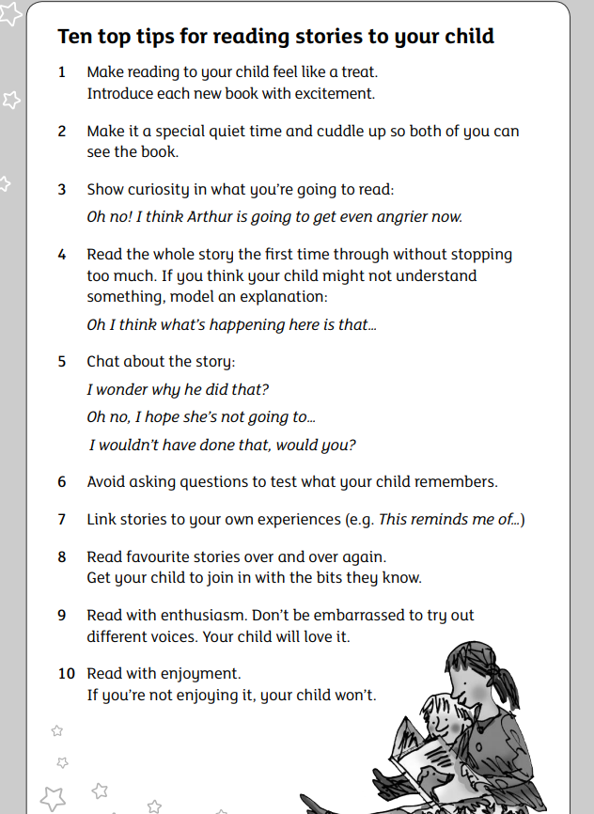
Reading at home with your child - library books
Chosen based on interest - not reading level
Develop a love of reading
Changed weekly

Slide 6
Read Write Inc Phonics
Daily phonics lessons
Letter sounds vs letter names
Group led to allow children to progress at their own pace
Keep up sessions
Chances to listen to, read and write sounds
Key vocabulary
Blending
Segmenting
Fred Talk, read the word
Fred fingers

Slide 7
Reading at home with your child - decodable books
Allow them time to segment and blend
Books linked to their individual knowledge
Re read sentences to improve understanding
Ask questions to check understanding
Letter sounds, not letter names
Spotting punctuation and talking about it’s meaning
Model expression

Slide 9
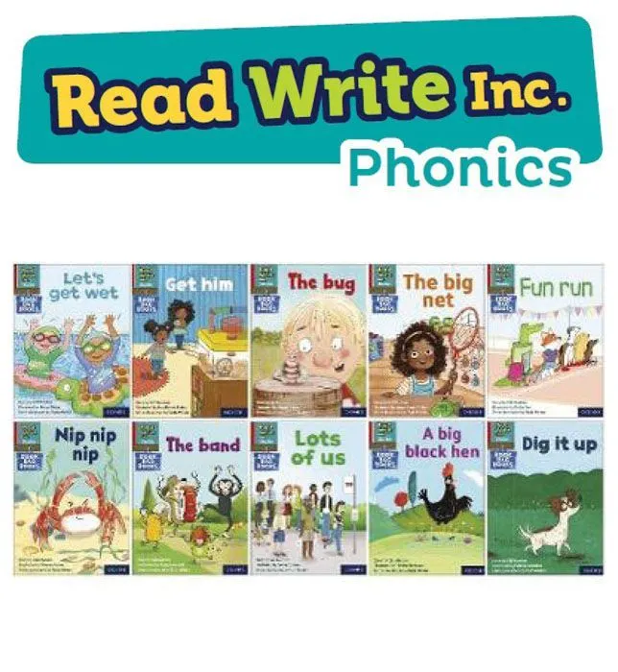
Our intent for Read Write Inc Phonics
High quality teaching of reading skills
Ensuring every child can read by the end of Key Stage 1 regardless of needs, abilities and background
For all children to pass the Phonics Screening Check in Year 1
Become confident in their reading ability, developing children into fluent readers

Slide 10
What does a Phonics lesson at school look like?
Taught in small groups by an LSA or teacher
Speed sound cards, one focus sound each day
Practice oral skills - say and blend
Magnetic letters for KS1 and Reception - letter recognition and spelling
Whiteboards - letter formation and spelling
Review previously learned sounds
Fred games
Reading activities - building on blending skills

Slide 11
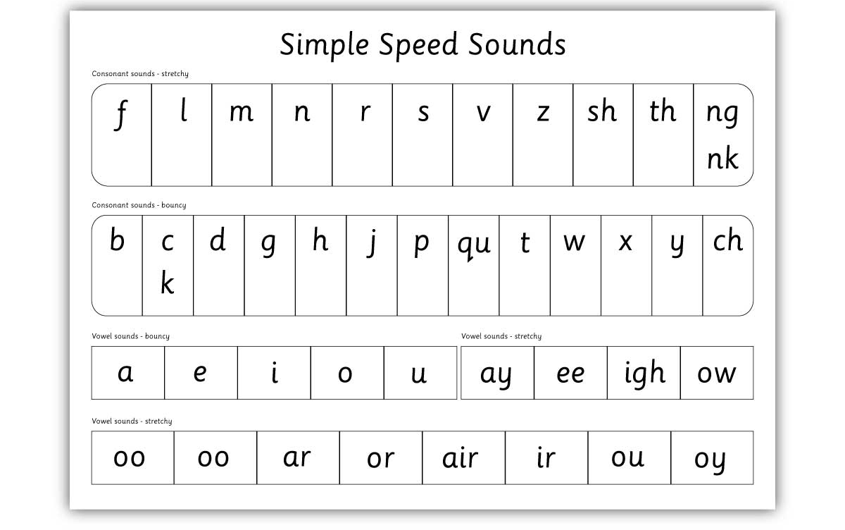
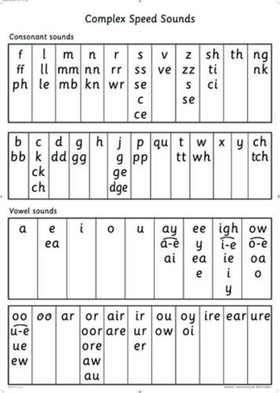
S
*Assessments every half term
S S
Set 1
Set 2 and 3

Slide 12
Additional Phonics - Fast Track tutoring
5 mins each afternoon 1:1 with LSA
Keep up with sounds (say, blend and read, write)
Review sound taught earlier that day
Revise previously taught sounds
Sounds continued to practice until mastered

Slide 13
Phonics books sent home
Decodable books based on child’s phonic knowledge
Sounds in lesson and Phonics book correspond
Building on blending skills + sound recognition

Slide 14
Supporting your child with Phonics at home
Your child to read everyday!
Shared reading
Virtual Phonics classroom
-links to online teaching videos
-practice sounds blending and reading at home
- Fred Games
Speed sound cards
Common exception words

Slide 16
Thank you!

