Slide 1
Communication and Language in the Early Years
Parent Workshop
24th February 2023

Slide 2
Communication and Language ELG
Getting your own message across
Expressing your feelings appropriately
Being able to listen
Paying attention
Interacting and playing with others
Understanding what is being said

Slide 3
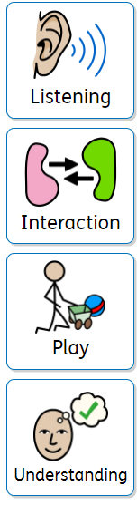
Four Areas of Effective Communication

Slide 4
Listening
Key skill for development
Noises all around us
Listening not hearing

Slide 5
Developing Listening
Listening games
Instructions - building them up
Rhyme and repetition - stories and poems
  Give clues
Show me/tell me

Slide 6
Interaction
We communicate and interact with each other in different ways. Learning the skills of interaction is really important for having good conversations and interactions with others.
We need to learn:
When to talk and when to listen.
How to take turns.
How to notice if someone is not listening or bored with what we’re saying.
We need words to do this, but also skills in looking, listening and noticing people around us. Children learn from adults by watching how they interact with other adults and with children.

Slide 7
Developing interaction
What is different?
Favourite things
  Modelling
  Sense of sense
  Intonation
Three good things
Charades
20 questions
I went to the market and bought…

Slide 8
Understanding
Understanding is key to talking and learning. Children need to understand what single words mean and when words are joined together into sentences, conversations and stories.
Children go through phases where they ask lots of questions. They are trying to find out how things work and understand the world around them. Adults play an important role in answering the many questions children have and in checking out whether children understand and modelling how to pose questions and what we do if we don’t know the answer.
Understanding helps us to:
Keep us safe
Be informed
Work out what is happening in a situation
Continue learning/moving forwards
Appreciate others’ feelings and express our own needs appropriately

Slide 9
Developing Understanding
Riddles
Sentence starters
Odd one out
Jabber jabber

Slide 10
Play
Play is a really important part of children’s learning and development. Children learn all kinds of skills through play; they learn how things work, how to interact and share with other children, how to play with different toys and to enter a world of imagination.
Playing enables children to test things out in a safe way, to learn about emotions and to talk with others. Children often love adults to play with them. It’s great if you can follow their lead and join in the fun.

Slide 11
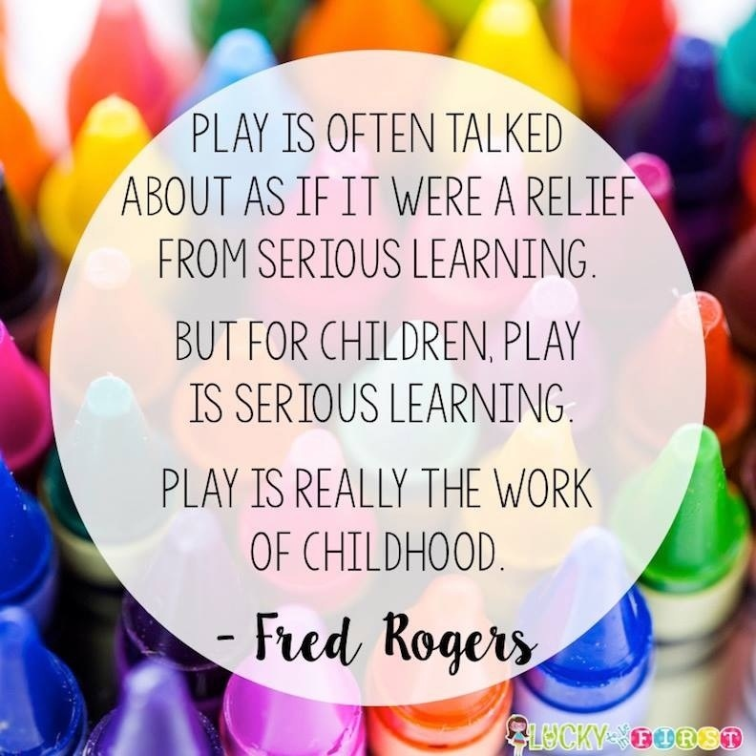
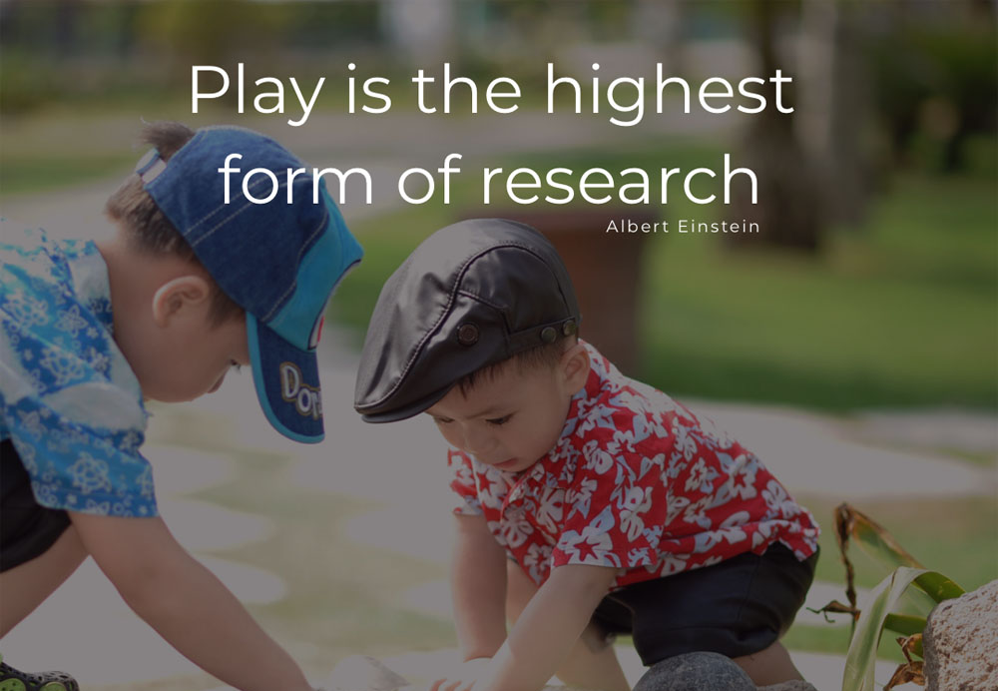

The importance of play

Slide 12
Developing play
Picture time
Board games
Spot the difference
Construction and small world
Gross motor play

Slide 13
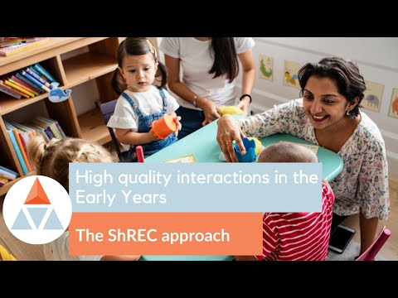
The ShREC approach

Slide 14
Developing vocabulary
Word rounds
What can it do?
Pobble 365
A is for…
Don’t say it/taboo
Word association

Slide 15
Support
Talking point - http://www.talkingpoint.org.uk/directory/free-resources-parents
The Communication Trust - https://www.thecommunicationtrust.org.uk/resources/resources/resources-for-parents/
The National Literacy Trust - https://literacytrust.org.uk/resources/tips-talking-your-baby-and-young-child/
Action for children - https://www.actionforchildren.org.uk/news-and-blogs/parenting-tips/2017/february/using-technology-to-help-childrens-communication-skills/

Slide 16
Key Messages
Tapestry
Wow Books
Uniform
‘Our day’ whiteboard

Slide 17
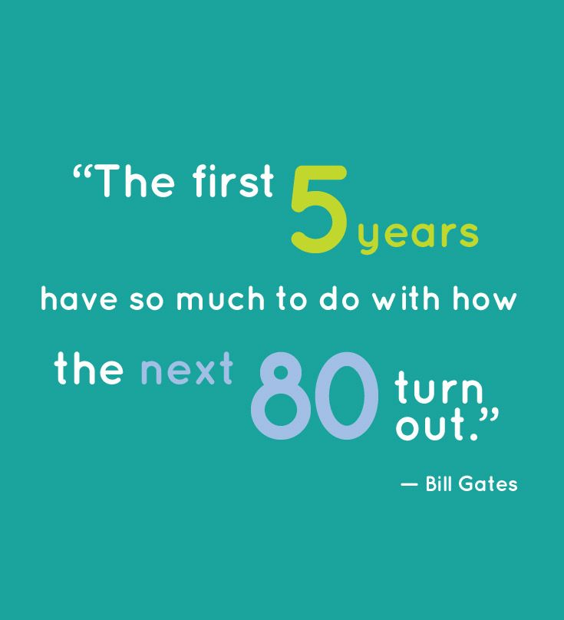

Slide 18

Any questions?

