Slide 1


Slide 2
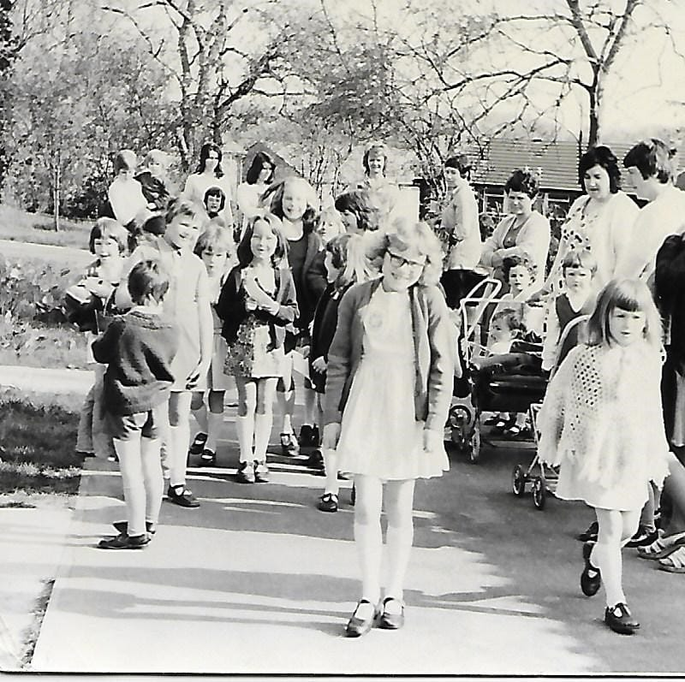
Mums and children gathering outside school on May 1st 1974,
the very first day of
Widmer End School.

Slide 3
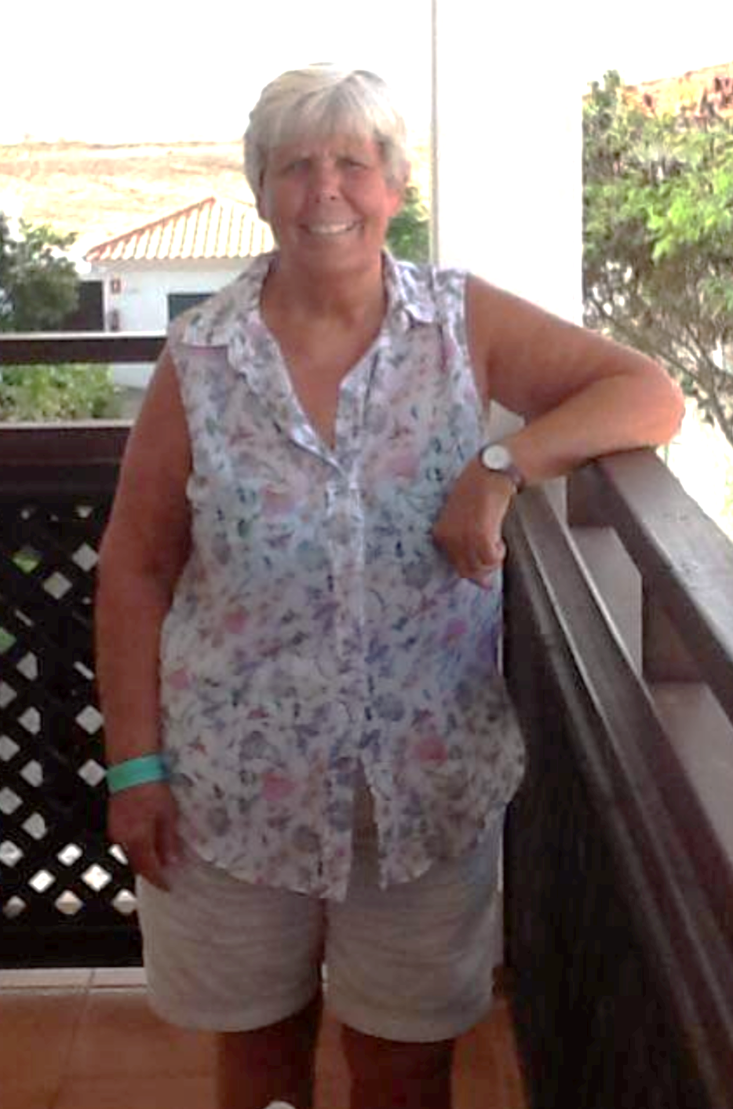
“I remember it so well. My son was there on the first day all those years ago.
He had to go to Cryers Hill School until Widmer End School was open.
I think the workmen were there and the school had to borrow some furniture from Cedar Park School.”
Barbara Ellis

Slide 4

‘The new school was due to open on 24th April 1974. On that day, although the keys were handed over, things were far from ready!’

Slide 5
‘Among other things, the playground was not surfaced and there were no telephones, typewriters or even chairs! There was also no caretaker!’

Slide 6
‘The school eventually opened on 1st May, with equipment borrowed from neighbouring schools.’

Slide 7
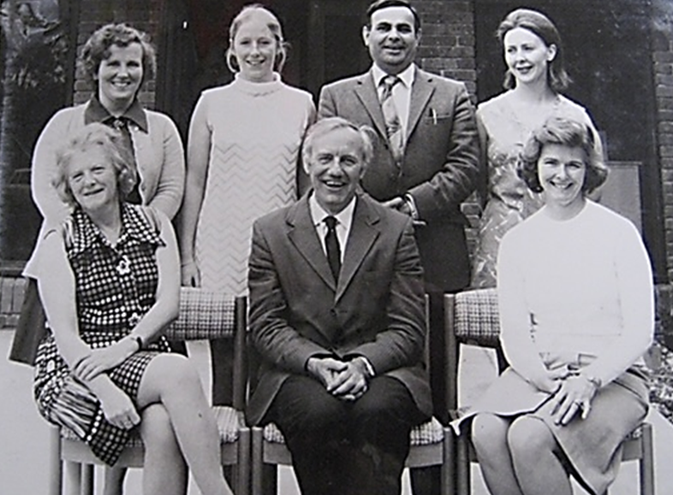
The original staff of Widmer End School, including Head Teacher Mr Jeffries.
( a navigator in Lancaster bombers in WWII!)
in World War 2!)

Slide 8
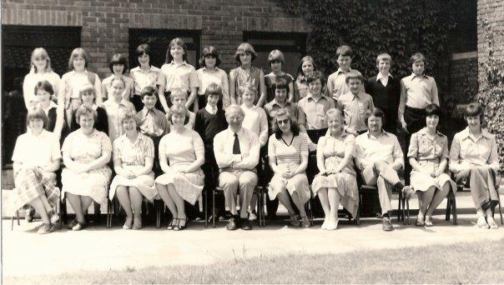
There were only 55 pupils
In Widmer End School in May 1974!
5!

Slide 9
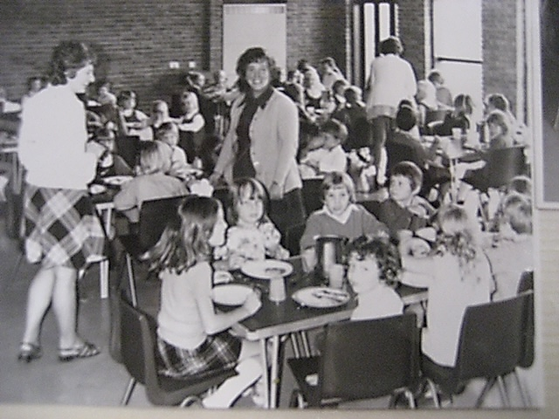
Mary Lawrence, who was a dinner lady in 1974, shared these photos with us.
The ‘Cafeteria’ in 1974

Slide 10
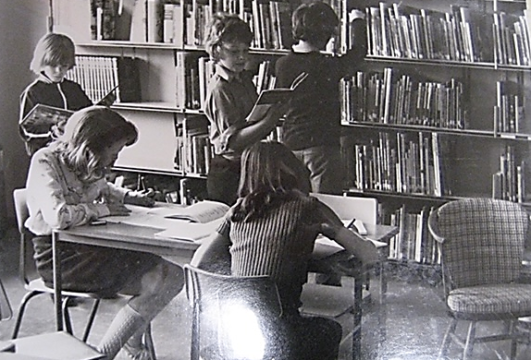
The Library in 1974

Slide 11
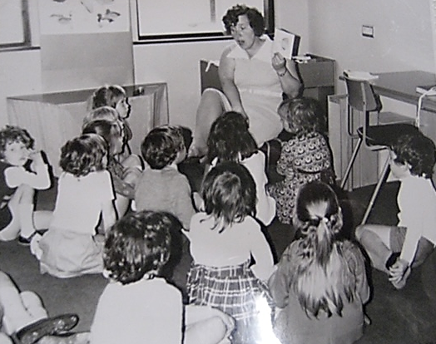
A Classroom in 1974

Slide 12
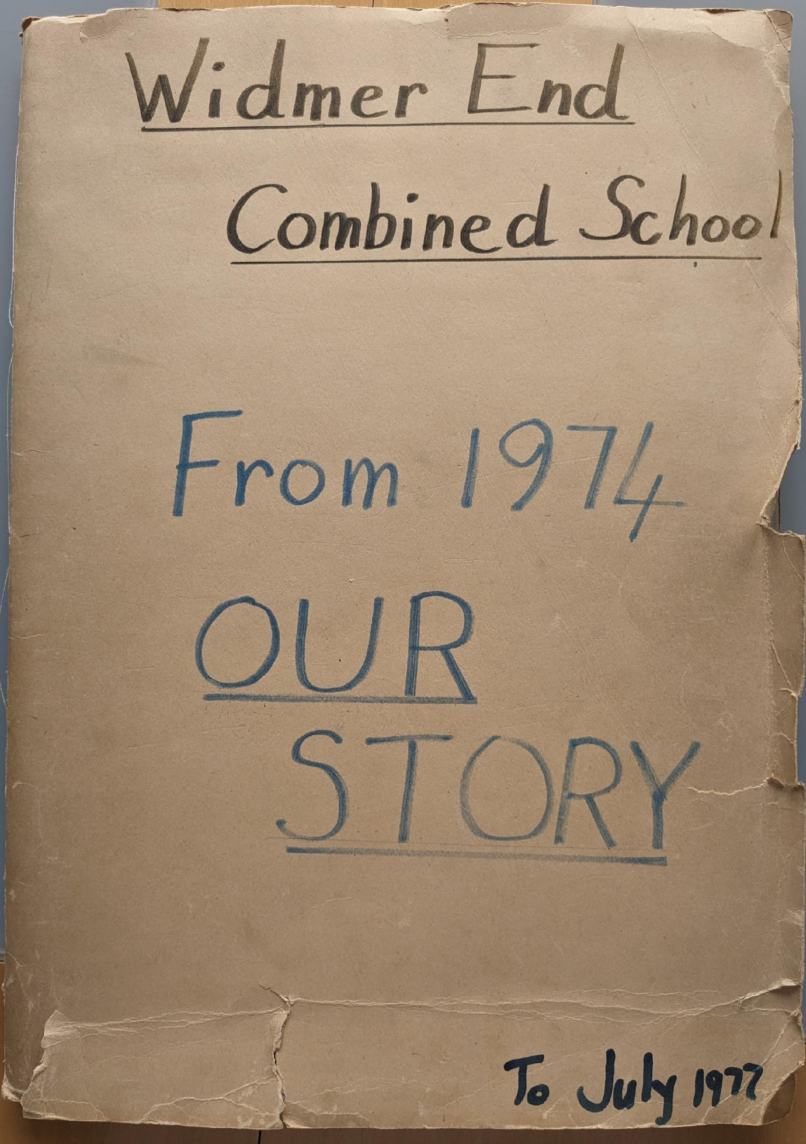
Helen Coates,
a Widmer End pupil from 1974, tells us all about that first week at Widmer End School

Slide 13
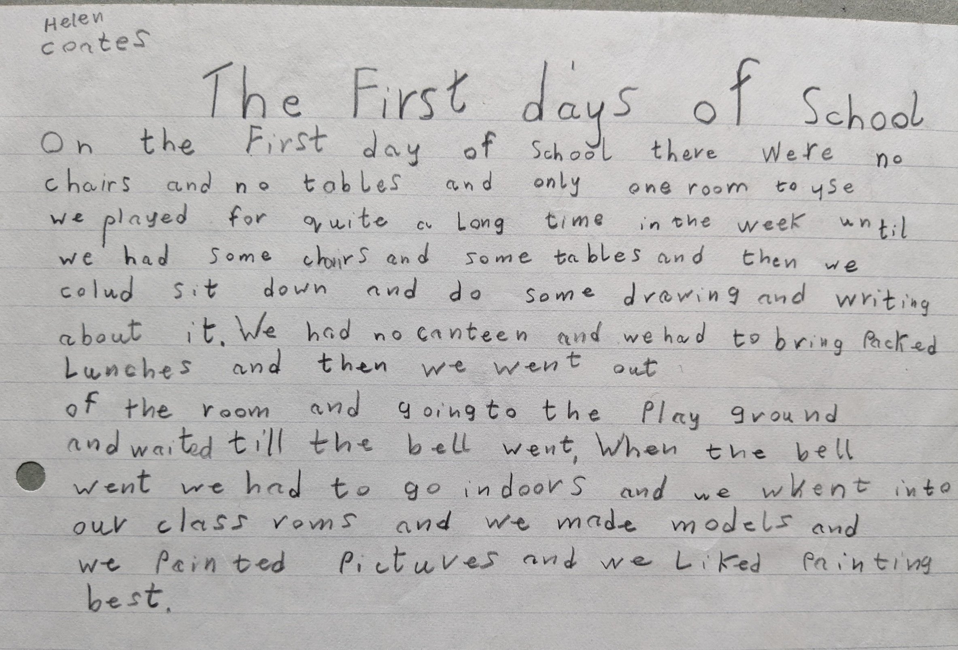

Slide 14
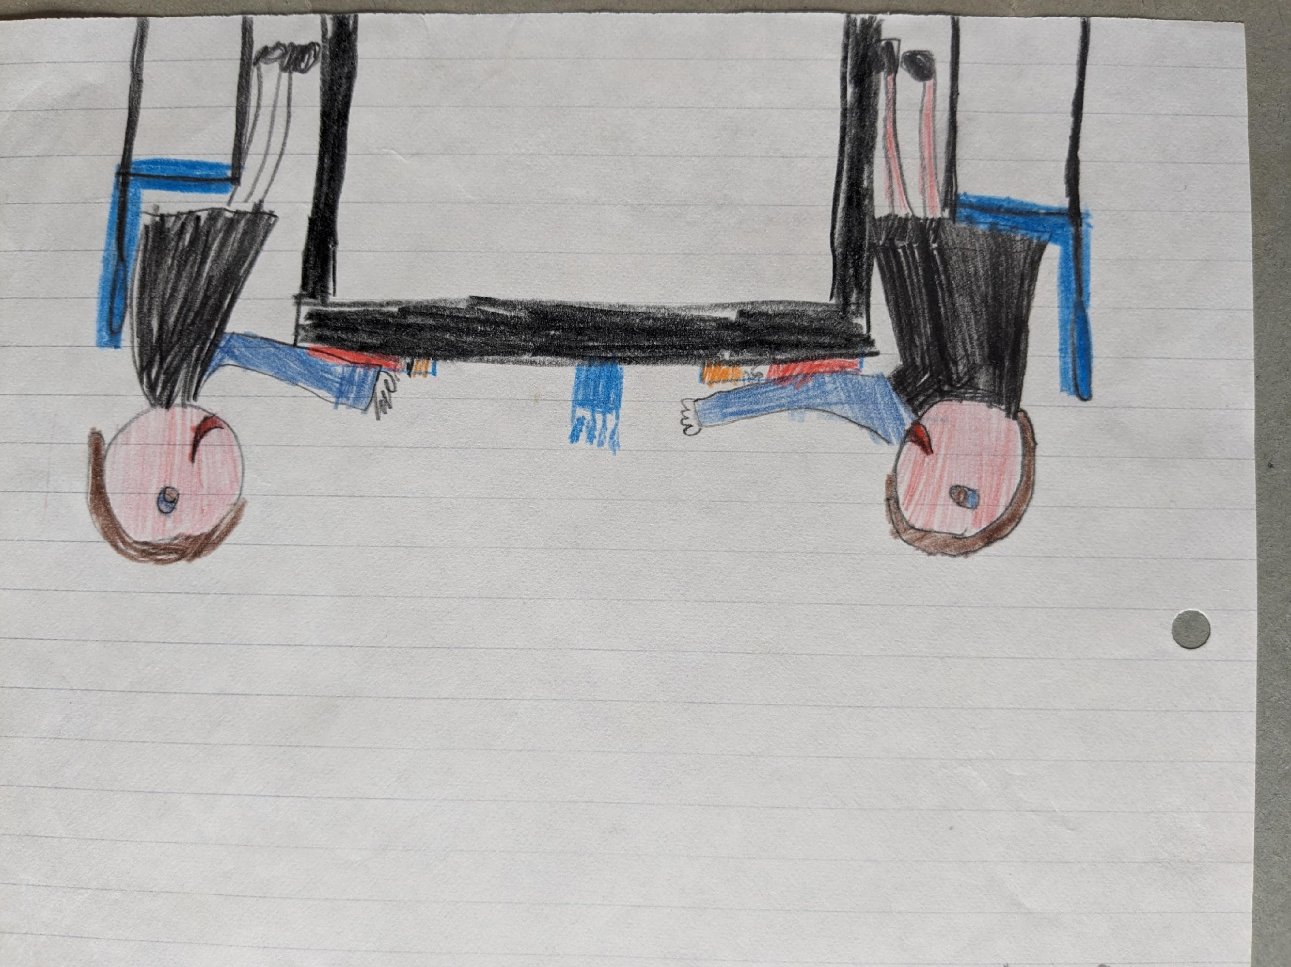

Slide 15
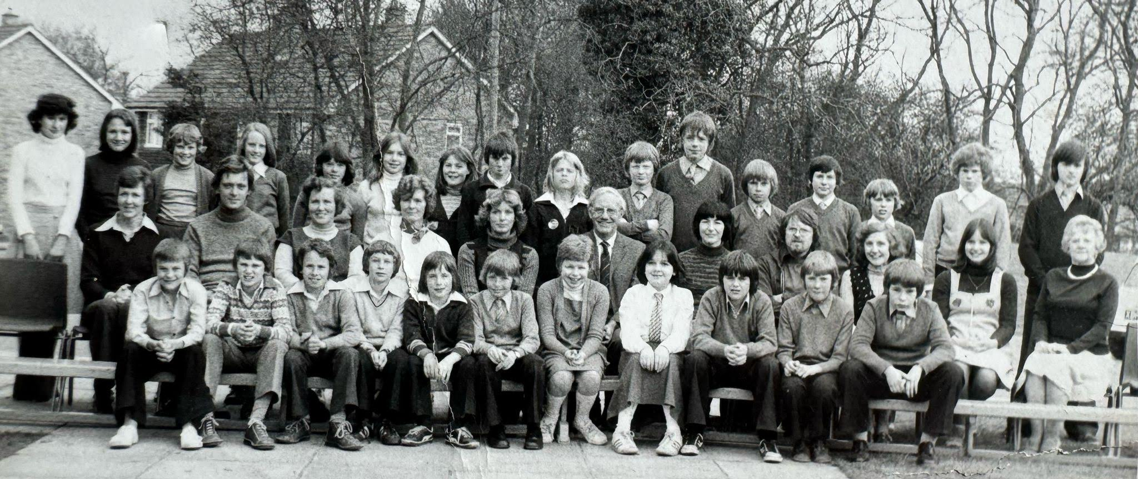
Pupil Mike Adams attended Widmer End School when it first opened, and shared this photo from 1976.

Slide 16
Pupils Emma and Mike
shared one of their early memories from school life. They said they used to talk too much when their teacher Mr Reid was speaking.

Slide 17
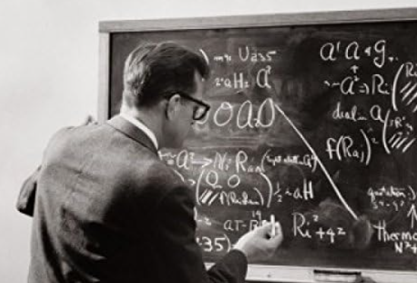
“I will never forget Mr Reid throwing the board rubber across the classroom at us!”

Slide 18
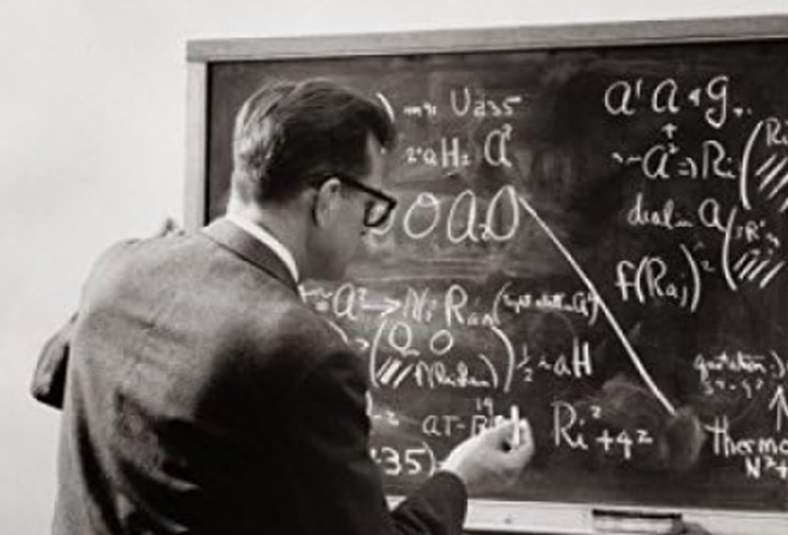
“We all got very good
at ducking quickly!”

Slide 19
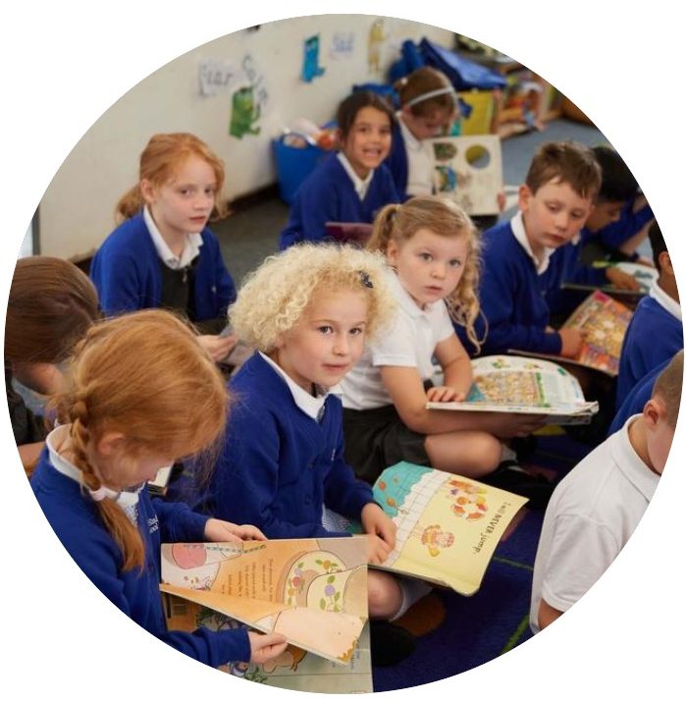
Widmer End School has grown from a little school of 55 pupils, to over 200 pupils over the past 50 years.
Many things have changed for the better!

Slide 20
But what hasn’t changed is that Widmer End School is,and has always been, a wonderful school with fantastic pupils and brilliant staff who really care.

Slide 21
Memory Book for
Pupils & Parents
2024

